Slide 1

Office of Research and Innovation Services
A Compelling Narrative:
A Tri-agency CV Information Session
January 28, 2026
Nicole van Rootselaar, PhD (Internal Funding, Undergrad & PDF Research Facilitator)
Nancy Barajas Jaimes (Institutional Awards Coordinator)

Slide 2
Today’s Goal
This session will introduce the Narrative CV, and provide an overview of the why, when, what, and what now? to help you begin preparing effectively.
To experience developing your own Narrative CV, please join us on February 4, from 11:00 to 12:00, for our TCV Workshop.
This session is being recorded.
Notes:
Introduce the why, what, and when so you can start preparing effectively.
• Introduce the Narrative CV and how it differs from a traditional CV
• Explain why Narrative CVs are being adopted in research assessment
• Clarify when you are likely to need a Narrative CV (e.g. funding, recruitment, promotion)
• Help you start thinking about how to prepare your own Narrative CV

Slide 3
Why are we here?
Narrative CV = Tri-agency CV
TCV

Slide 4

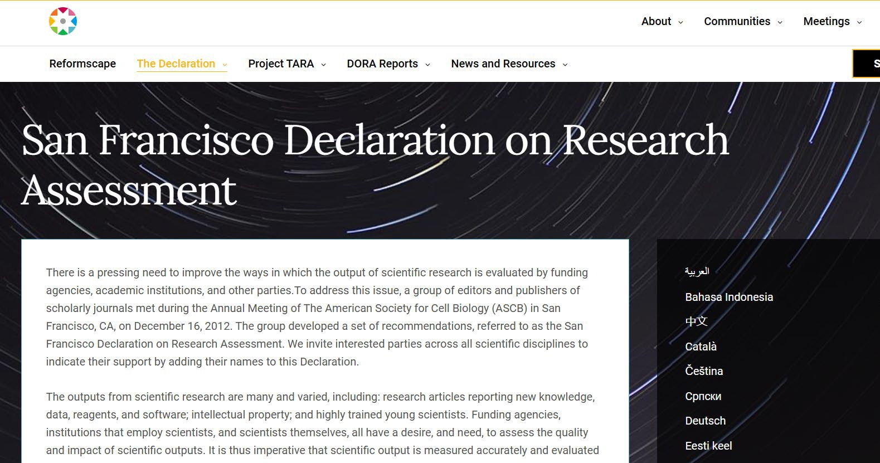

Slide 5
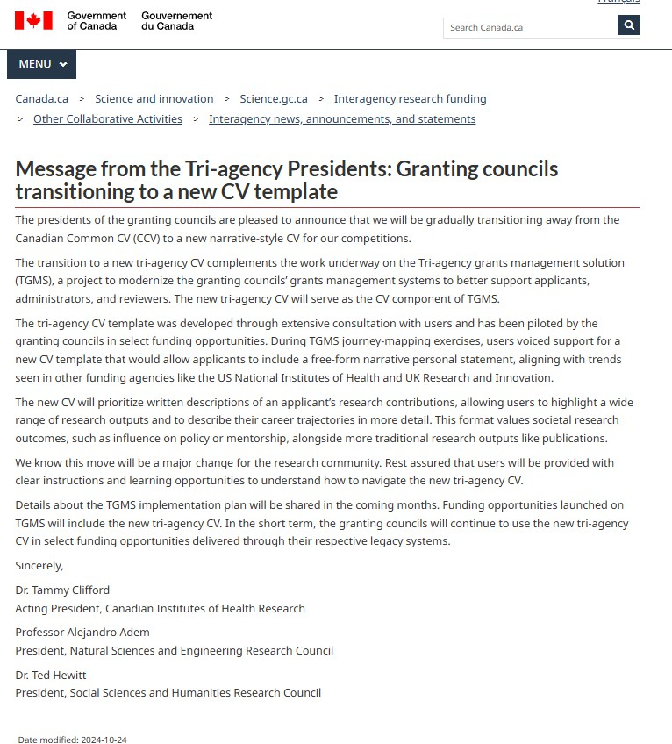
October 2024: Tri-agencies release a very vague announcement

Slide 6

TGMS = A single, new platform for all Tri-Agency applications

Slide 7
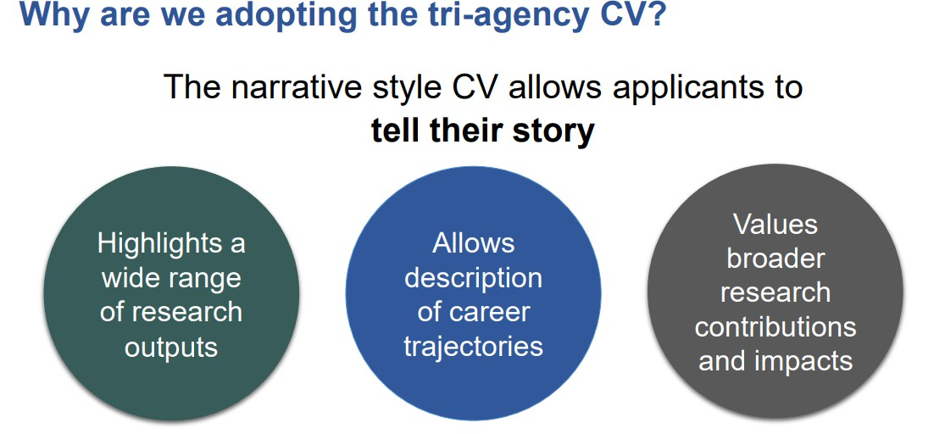


Slide 8
Tri-Agency CV Template:
Personal Statement
  Why are you well suited for this role?
Most significant contributions and experiences
    Top 10: Highlight your contributions related to the proposal and their impact, significance, usefulness
Supervisory and mentorship activities
How did you help mentor/train future generations?
Links to TCV templates found on Ulethbridge
Narrative CV page
Notes:
Double check and select this slide or the next one
[Add link to underlined and qr code]

Slide 9
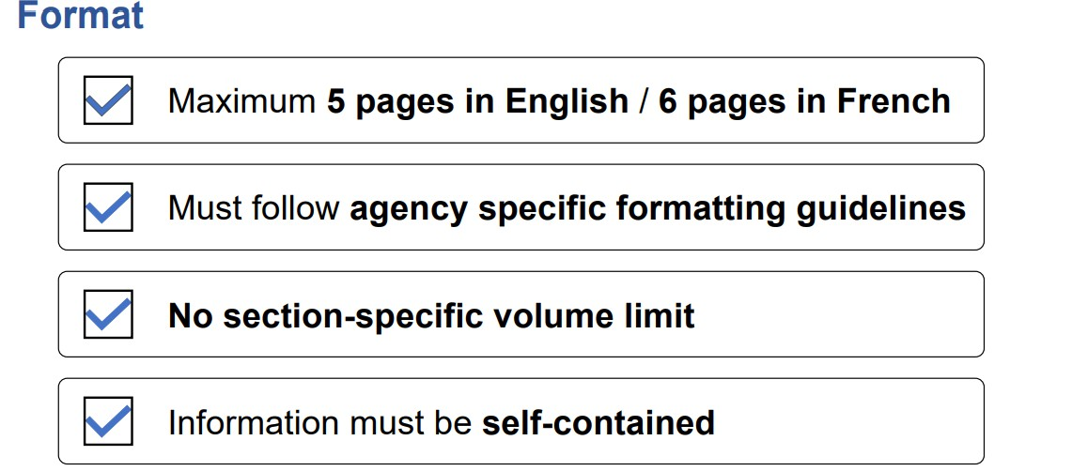

Slide 10
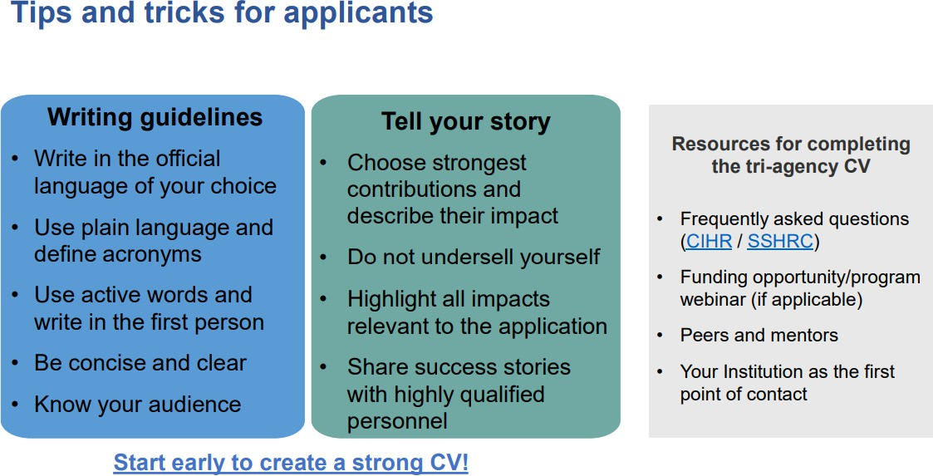

Slide 11
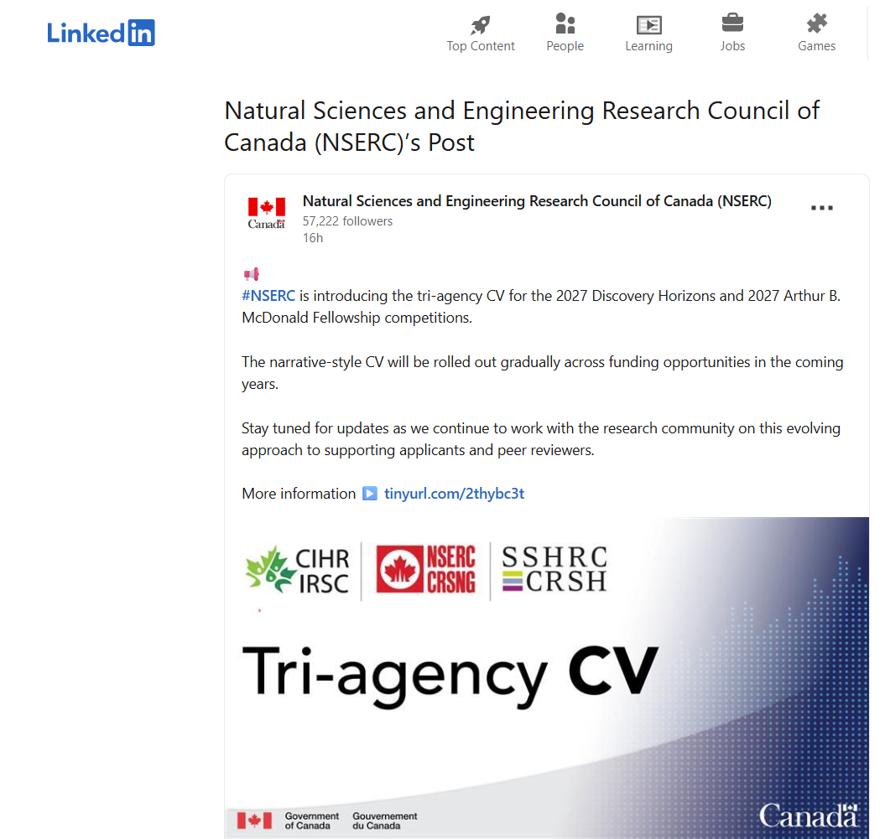
Notes:
NSERC has been piloting a narrative CV in the Discovery Horizons program for the past four competitions, hence facilitating its transition to the tri-agency CV. Moving forward, applicants will no longer be limited by a six-year window and will be able to include contributions and experiences spanning their entire research career in their tri-agency CV.
The implementation of the tri-agency CV in the Arthur B. McDonald Fellowships will involve specific changes to the nomination package, including changes to the nomination letter to reduce potential overlap with the content of the tri-agency CV. The following changes will be applied to the nomination package:
Form 100 and the three-page description of the nomination (first section of the nomination letter) will be removed.
One page will be added to the “Future directions” section of the nomination letter for nominees to describe their proposed outreach, mentorship and leadership activities (past achievements must be included in the tri-agency CV).
Nominees will be required to submit a tri-agency CV appendix in addition to the tri-agency CV.

Slide 12
ORIS Update:
TCV is a work in progress
    Fall 2027 is the earliest possible competition for CHIR PG, NSERC DG, SSHRC IDG
    Limited Tri-agency examples
Some Tri-agency guidelines for reviewers
Many questions/concerns….
    A new opportunity!

Slide 13
Awards Update:
TCV is a work in progress
Iterative
Lengthy process
                Reflection
                Collaboration

Slide 14

Awards Update:
TCV is a work in progress
Source: https://www.cuinsight.com/auto-lenders-get-your-head-under-the-hood-be-a-thought-leader/

Slide 15
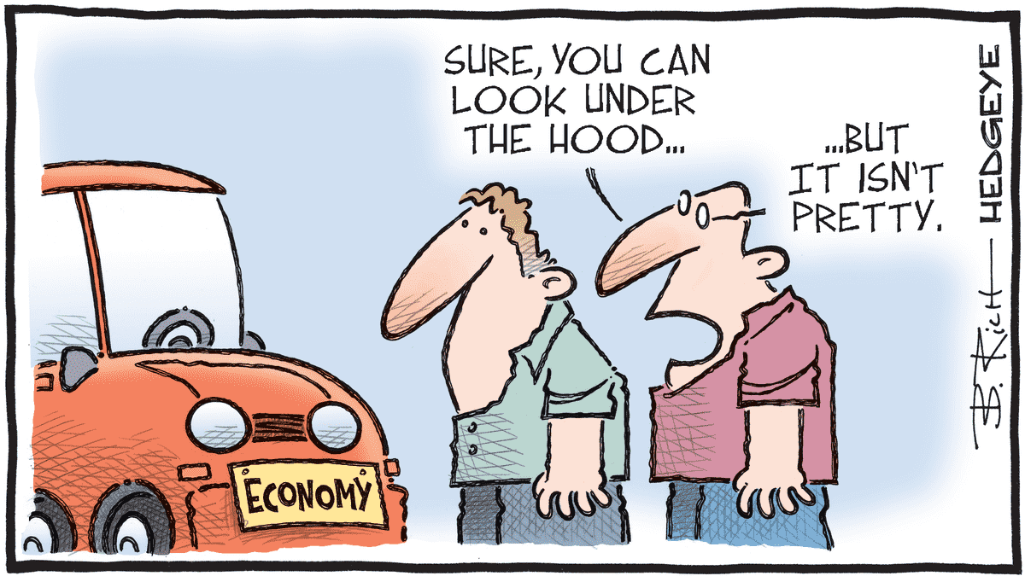
ORIS Update:
TCV is a work in progress
Source: https://app.hedgeye.com/insights/144987-cartoon-of-the-day-check-engine-light

Slide 16
Example: ORIS Process with our 1st TCV
What is your story? What are you proud of?
Re-organize your CV into the 3 sections
Whiteboard ideas (categorize story)
Evidence (lists, impact factor, journal names) vs
Impact (who was affected?, how were they affected?, what did you change for a specific topic/field/population?

Slide 17
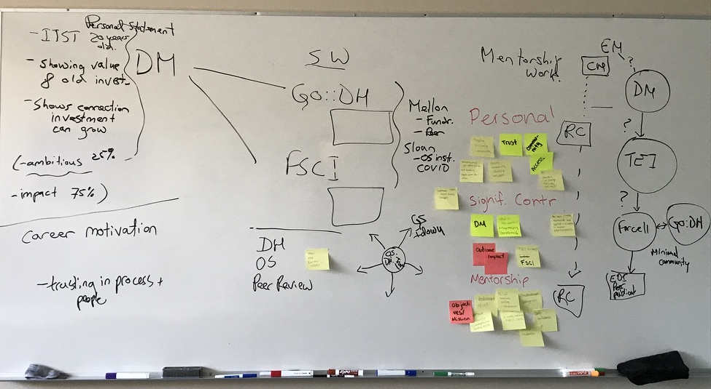
ORIS Update:
TCV is a work in progress

Slide 18
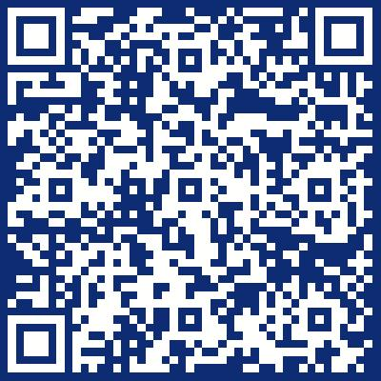
Next Steps:
Visit the ORIS website for resources and keep in touch
Get curious and approach it as a learning opportunity to develop new skills
Reflect on your professional trajectory, work impact and motivations
Start soon – It can inform your research approach and grant applications (knowledge mobilization).

Slide 19
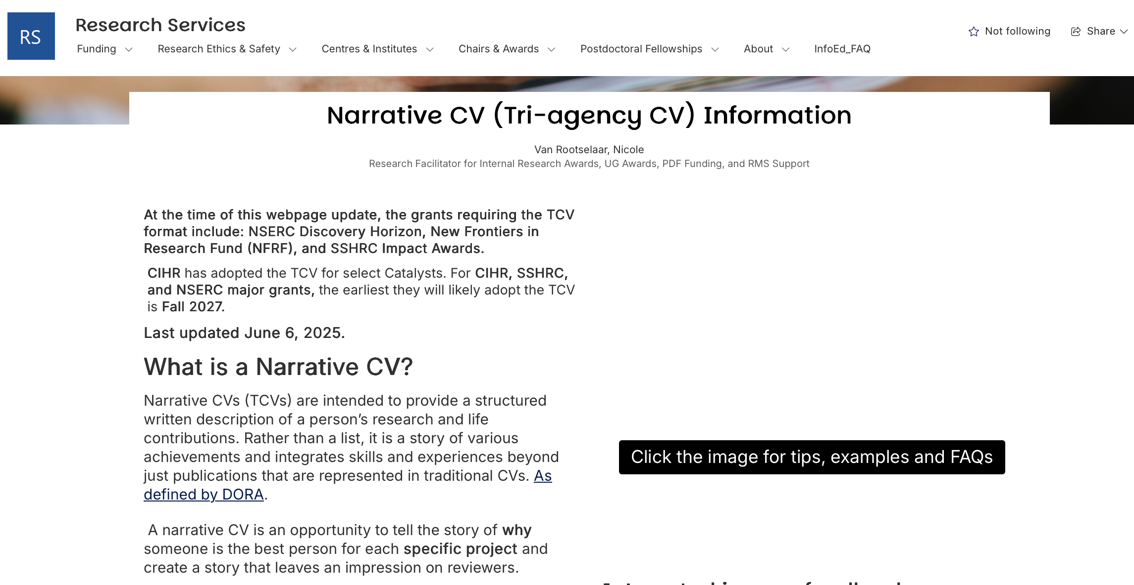
ORIS Website:
TCV Resources

Slide 20
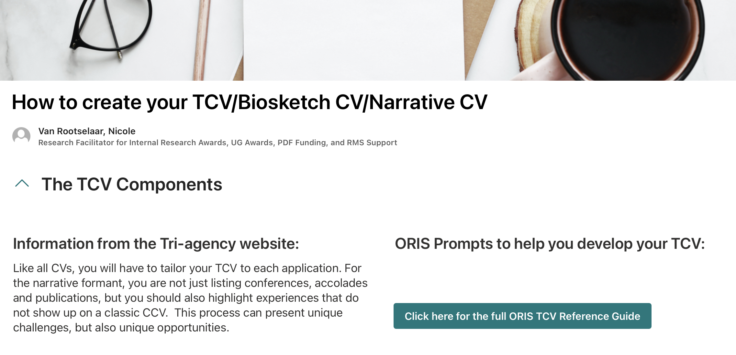
ORIS Website:
TCV Resources

Slide 21
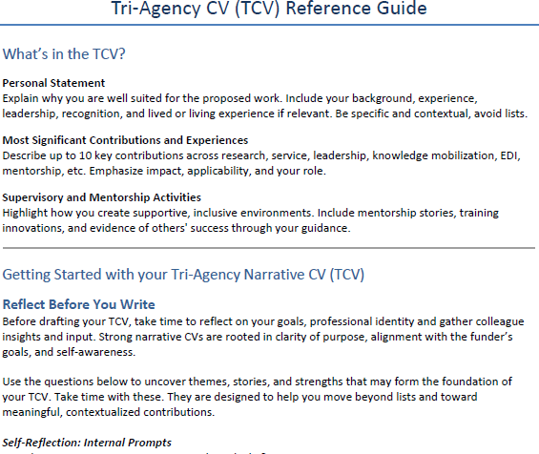
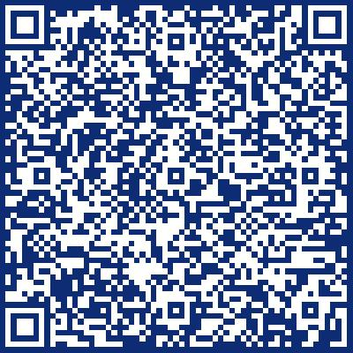
ORIS Website:
TCV Guide

Slide 22
Next Steps:
What can we do to support you on this journey?
Who could you connect with, or what additional resources could you leverage to support you in this process?
Has anyone had experience adjudicating using narrative CVs? If so, could you share your experience?

Slide 23
To Conclude
TCV requires practice, reflection and collaboration
Take advantage of starting early; do not rush it.
TCV Workshop February 4, from 11:00 to 12:00
- bring a laptop and your current CV
Grad Student Narrative CV Workshop: March 5th, register through “My Experiences” or email mhebert@uleth.ca

Slide 24
Thank you
Nicole van Rootselaar, PhD
Internal Funding, Undergrad & PDF Research Facilitator
Nancy Barajas Jaimes
Institutional Awards Coordinator
TCV Resources
TCV Guide

